Slide 1
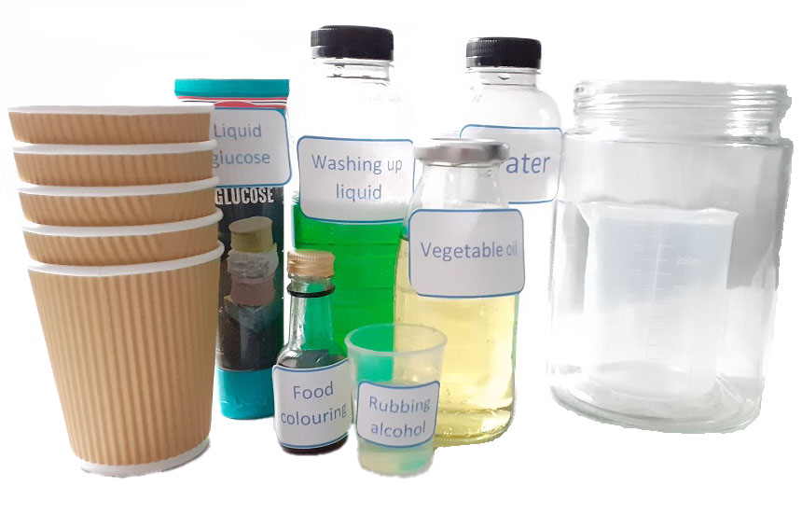

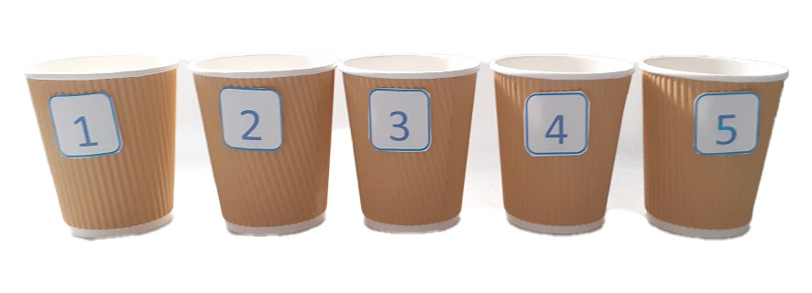
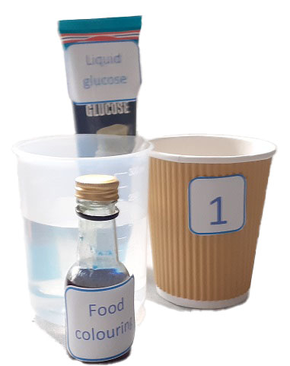
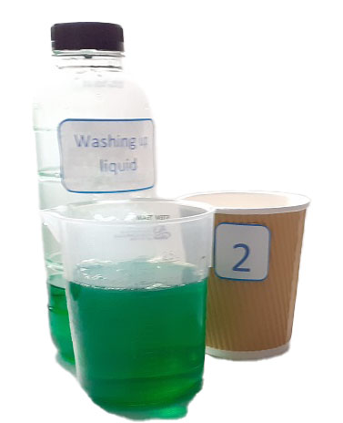
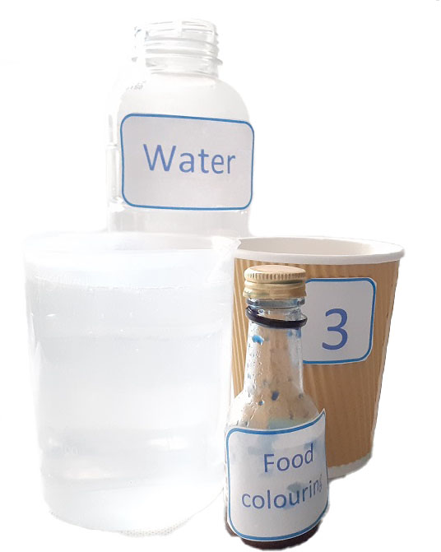
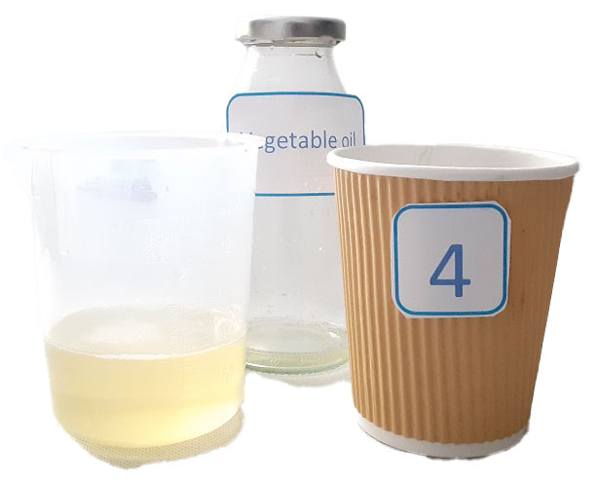
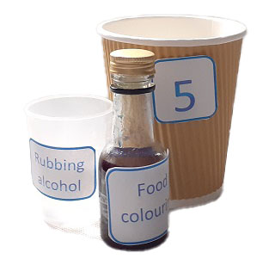
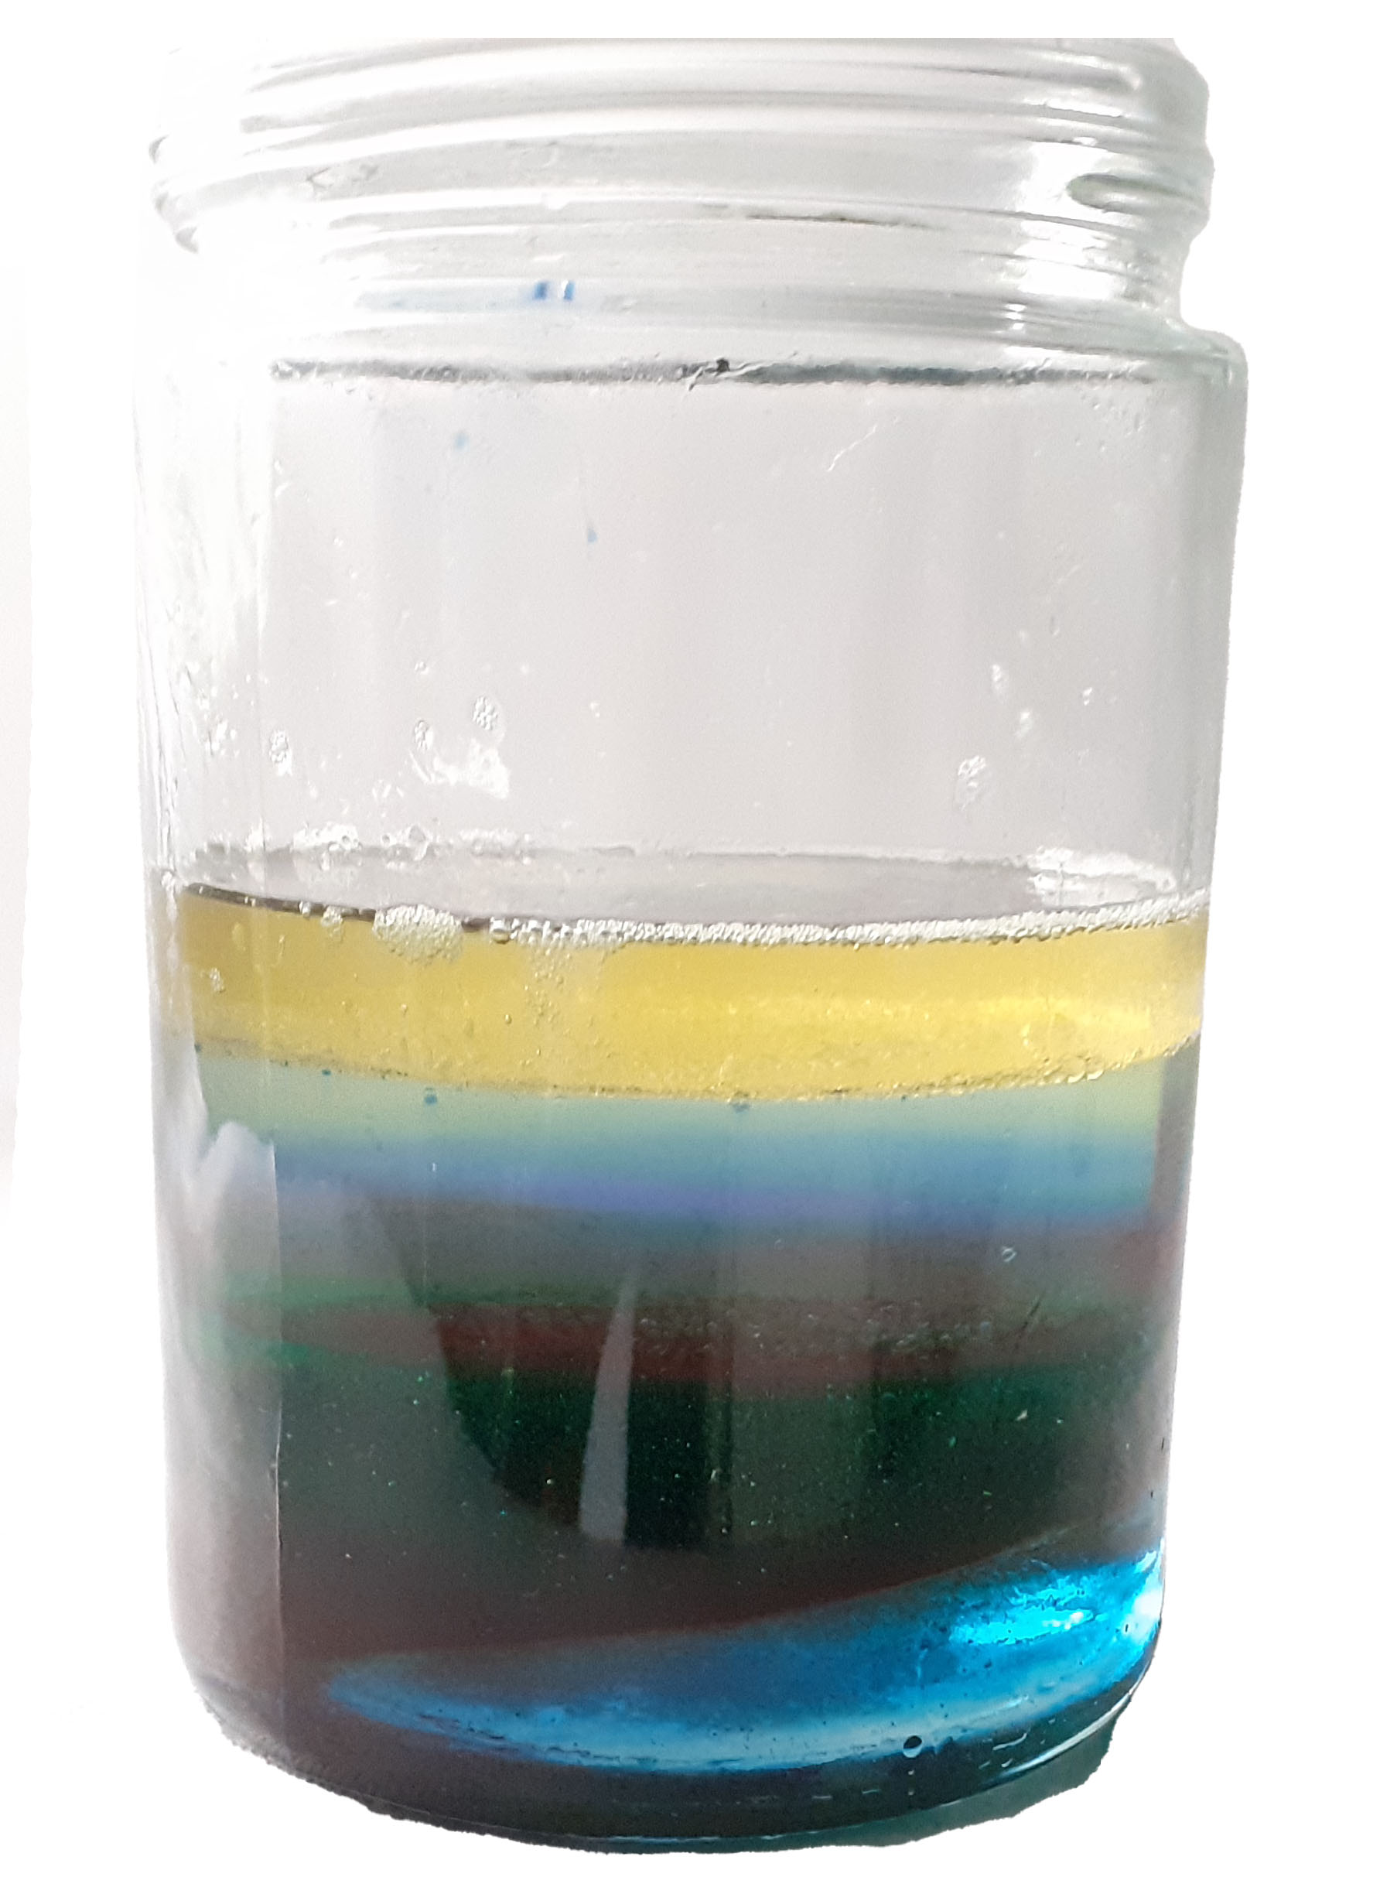
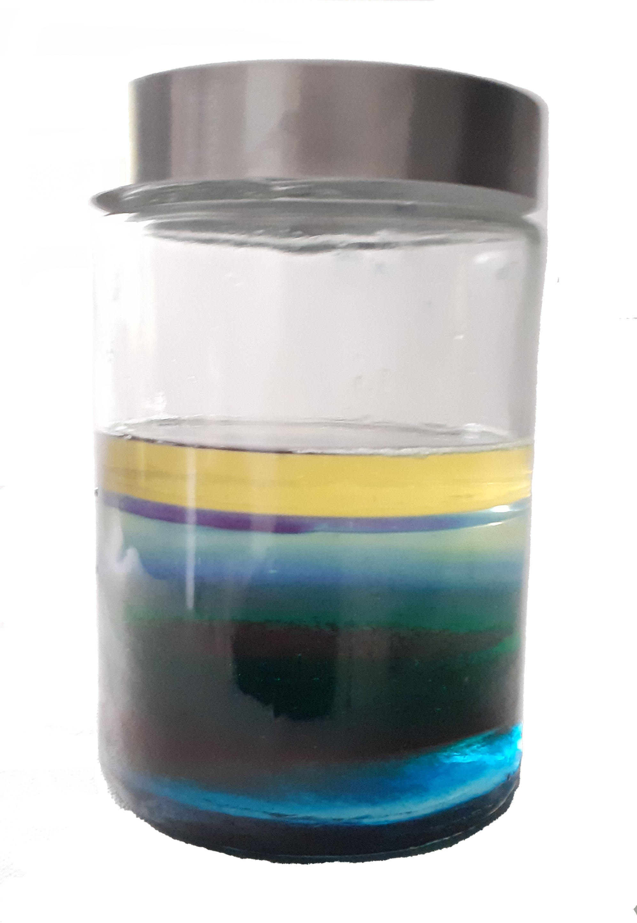
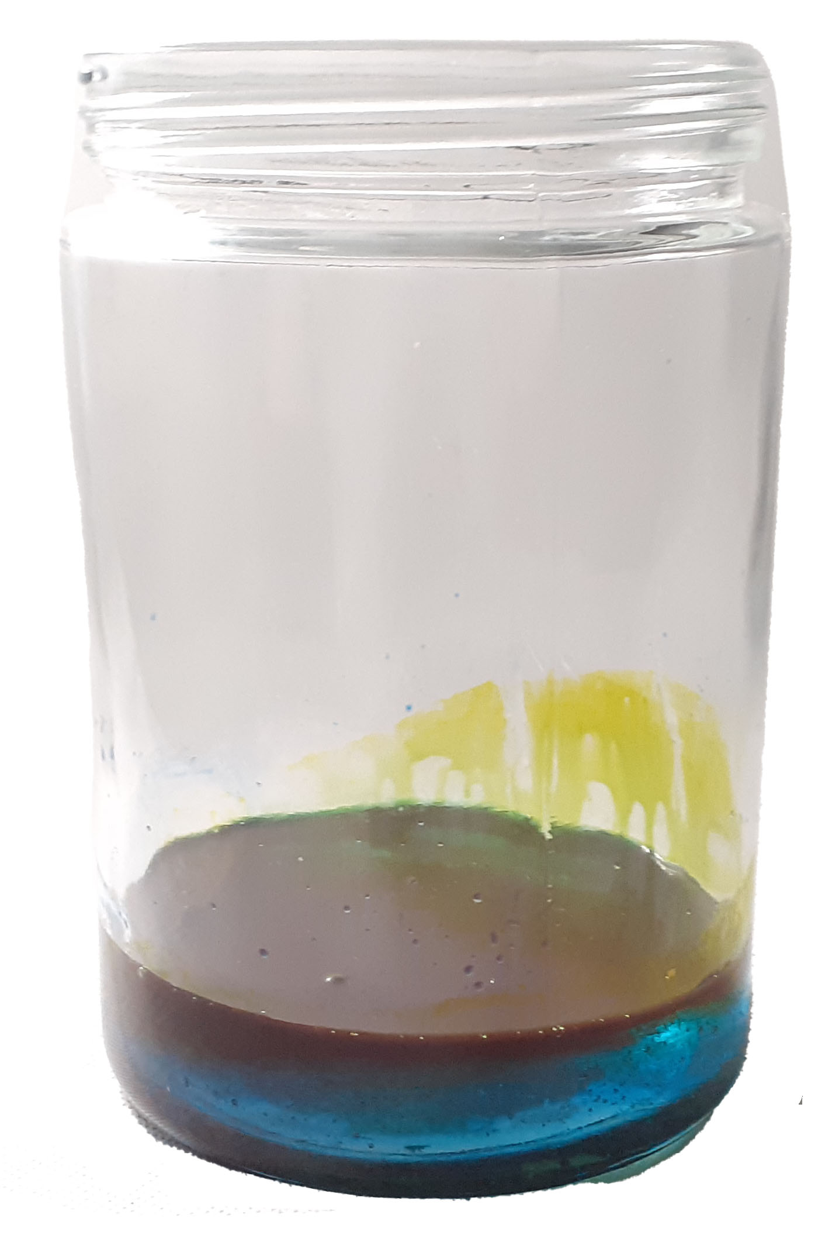
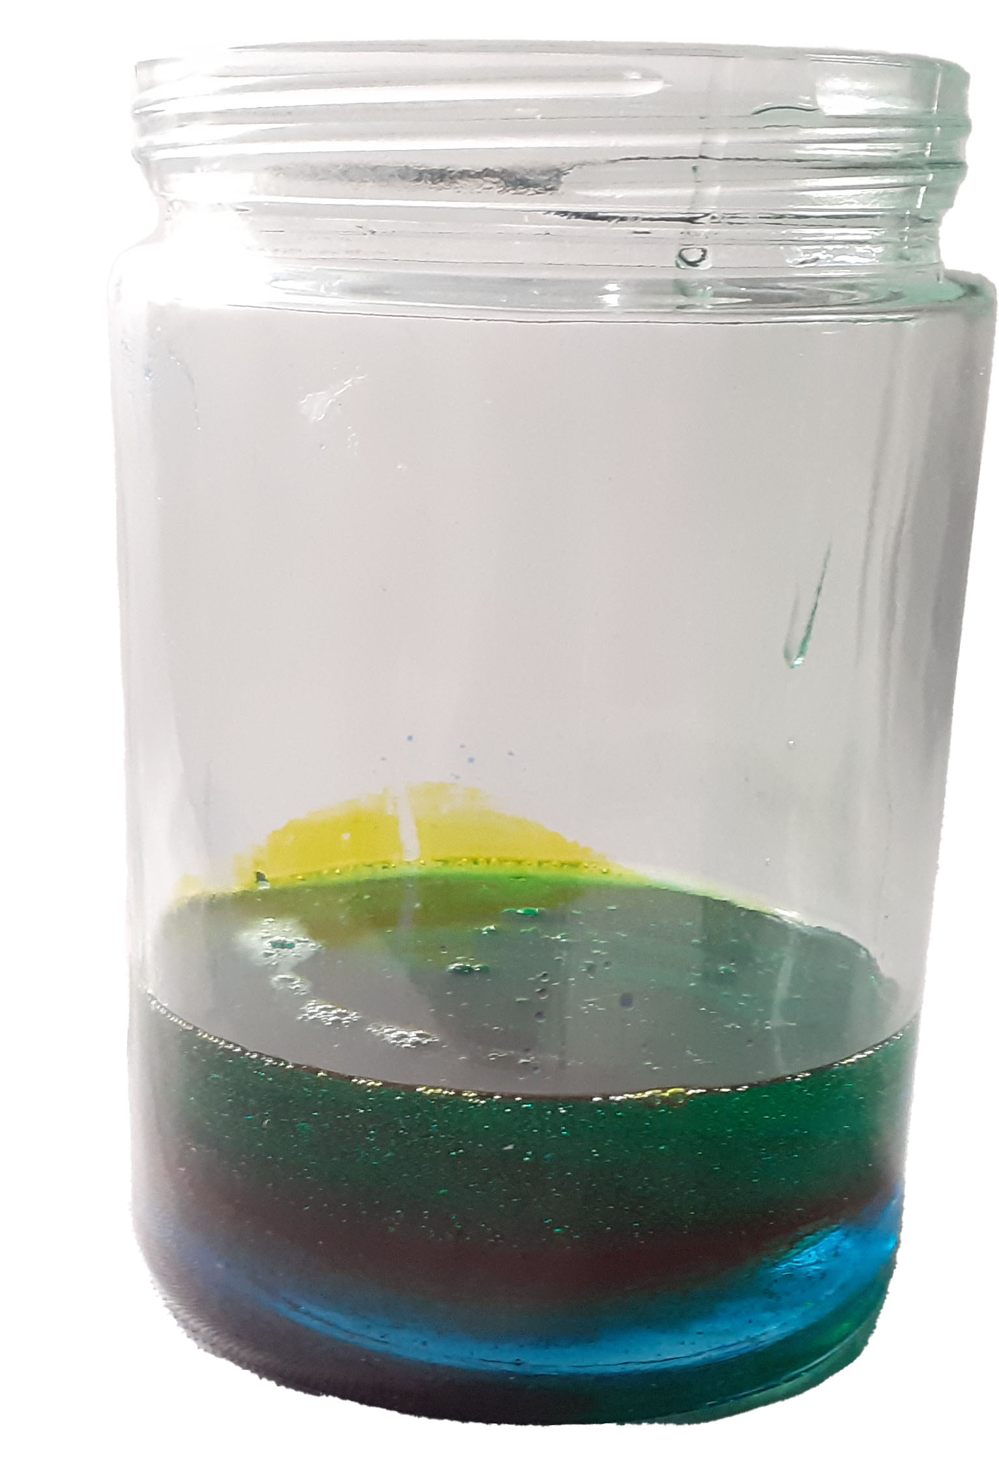
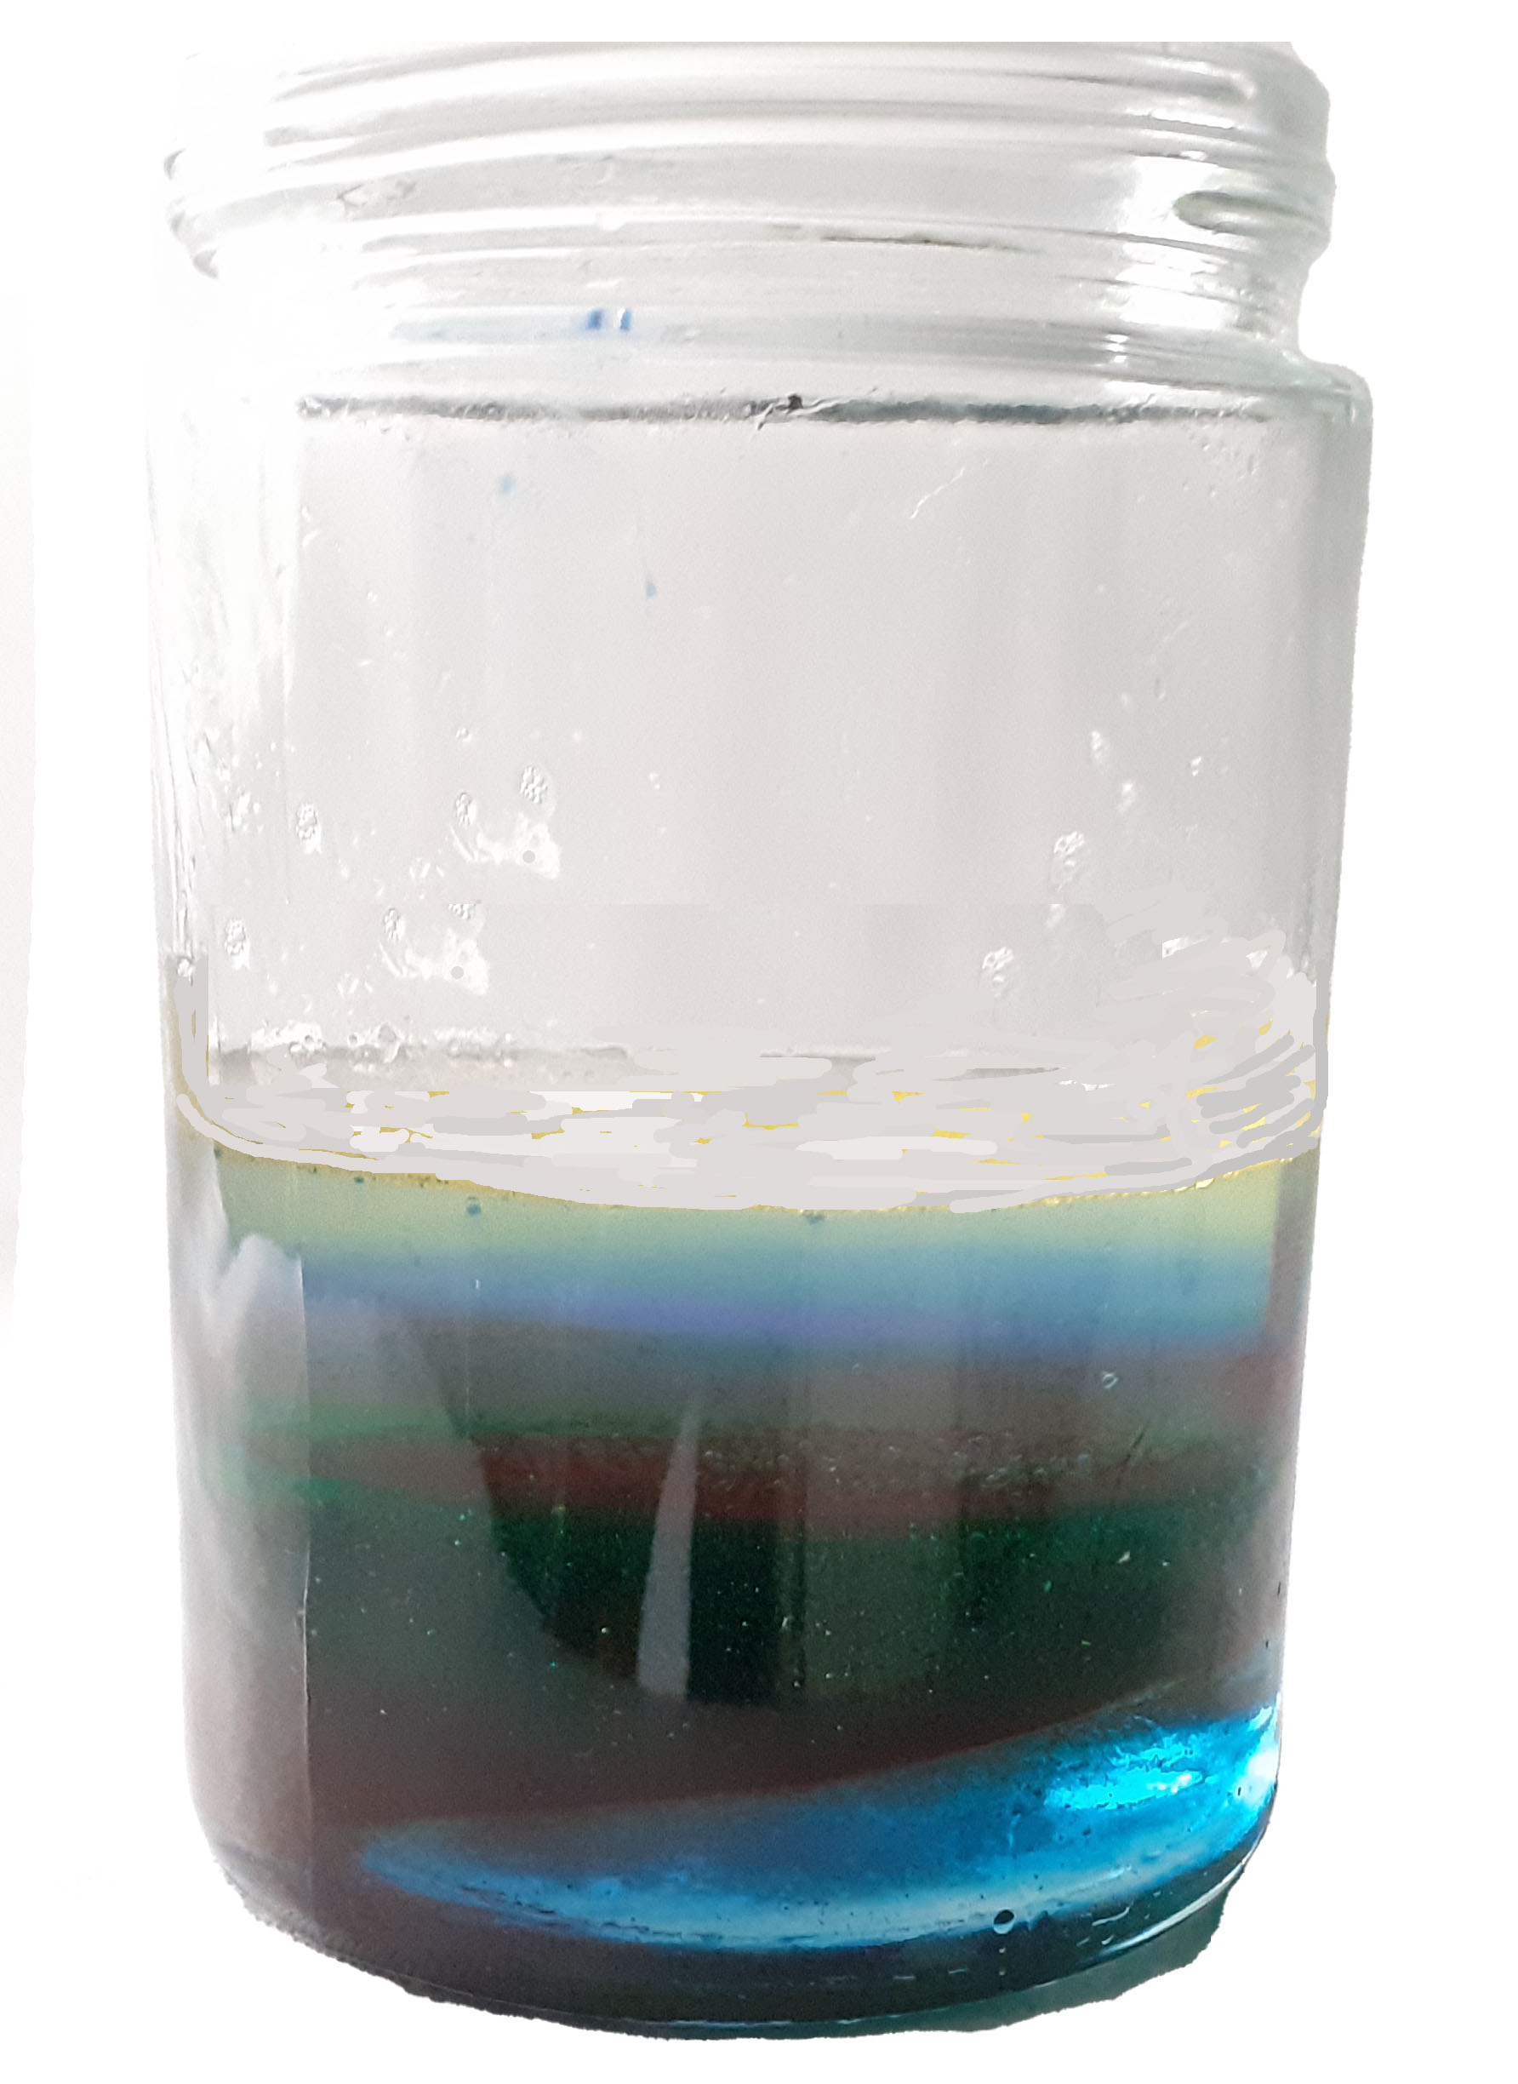

Ocean Layers
Explore the layers of the ocean with a liquid density jar.
What you need
• Large jar or clear plastic container • Food colouring (blue/ green) • Measuring Jug • Liquid glucose • Washing up liquid (green or blue)
• Water • Veg oil • Rubbing alcohol • 5 cups/ containers • Optional: funnel
1.
Lay out your five cups in a line and label 1 to 5.
2.
Measure out your ocean layers
Cup 1 - pour in 200ml liquid glucose, add 25ml blue and 20ml green food colouring and mix well.
Cup 2 - pour in 200ml
of washing up liquid.
Cup 3 - pour in 300ml of water and add 30 drops of blue food colour and mix.
Cup 4 - pour in 80ml of oil.
Cup 5 - pour in 20ml of rubbing alcohol add two drops of blue food colour.
.
3.
Place your large jar on a stable surface and pour/spoon in the contents of cup 1 (glucose syrup).
4.
Carefully pour in the contents of cup 2 (washing up liquid) so that the solution lies on top of the glucose.
5.
Carefully pour in the contents of cup 3 (blue water) so that the solution lies on top of the washing up liquid.
6.
Carefully pour in the contents of cup 4 (oil) so that the solution lies on top of the water.
7.
Carefully pour in the contents of cup 5 (rubbing alcohol) so that the solution sits on top of the oil.

Slide 2
The Science
Oceans cover two thirds of the earth. The depth of the ocean varies depending on where your look; at its deepest it is deeper than the height of Mount Everest. The Challenger Deep, part of the Mariana Trench, is 10,944 meters deep.
Oceans are made up of five layers, the layers you created during the experiment. The top layer is only about 200m deep and this is where the sun penetrates the most and where we find seaweed, coral, a variety of fish and other ocean living species. This is called the Sunlight Zone; in your model this is represented by the rubbing alcohol. The next layer 200m to 1000m is called the Twilight Zone (the oil in your model). Only faint sunlight reaches this layer and no plants grow here. It is home to sea species which often have large eyes to make use of the limited light, for example octopus and swordfish. From 1000m to 4000m you have the Midnight Zone (represented by the blue water). Very little penetrates to this level, so the zone is very dark. Fish and animals are specially adapted to survive in the darkness and increase in pressure at these depths. Next is the Abyss (the washing up liquid), 4000m to 6000m, sunlight cannot reach this layer and it is pitch black. Very few species live here, those that do are mainly transparent, blind invertebrates such as squid. Finally, we have the Trenches, everything below 6000m (the liquid glucose in your model). There is no natural light here and the pressure is immense but some creatures, such as sea stars, do exist here.
How does your model work? This is in essence a density column. Each solution has a different density, the denser an object is the heavier it feels.
Here you have five different solutions with the densest being liquid glucose. Did you find this hard to pour? This is because it is a solution with a high percentage of sugar and is dense. Washing up liquid is less dense than the liquid glucose, so it does not sink into it but forms a layer on top. Similarly, water is not as dense as the washing up liquid, so it lies on top. This principle applies at each layer so if you are careful when adding the solutions, you end up with a jar with each solution forming a band above the denser solution underneath.
Sunlight
You now have a density column which shows the different layers of the ocean. Label these if you want.
Twilight
Midnight
Abyss
Trenches

