Slide 1



University of the Highlands and Islands (UHI)
Where learning means more
Far a bheil ionnsachadh a’ ciallachadh barrachd
uhi.ac.uk

Slide 2
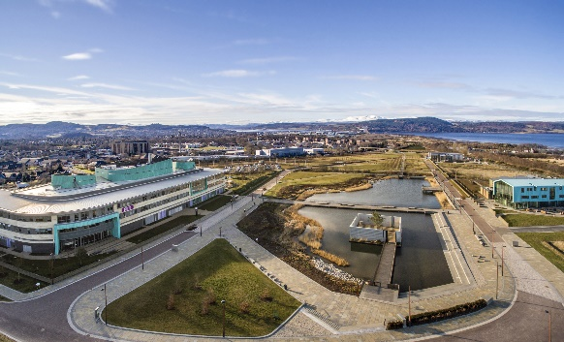


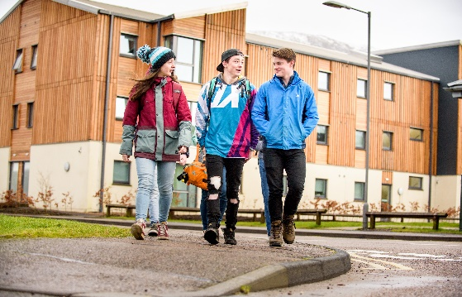
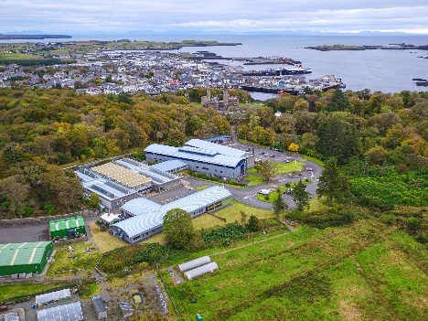



A university like no other
  Multi-campus university​​
  Second largest student population in Scotland​
  Diverse range of courses ​
  Excellent teaching facilities​
  Strong industry links​
  Flexible entry and progression routes

Slide 3
5
85
%
th
Highest student satisfaction
in Scotland
Student satisfaction
in National Student Survey
100
93.4
%
%
Student satisfaction
Student satisfaction
for Audio Engineering, Theatre Industry Practice, Criminology and Food, Nutrition andTextiles Education*
in Student Satisfaction and Engagement Survey**
*NSS 2025
**SSES 2025

Slide 4
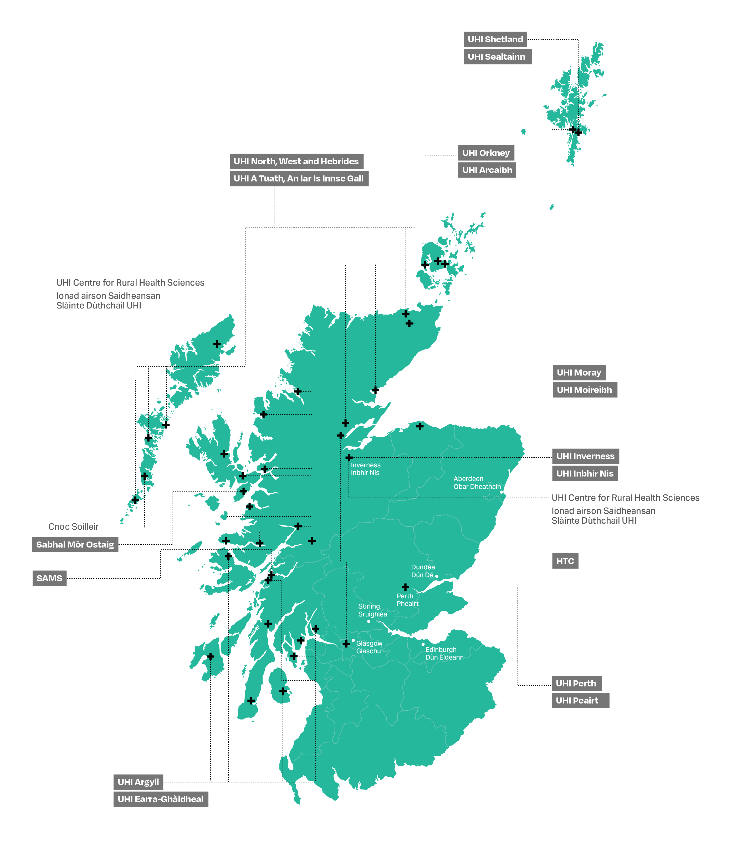
Where can you study?

Slide 5


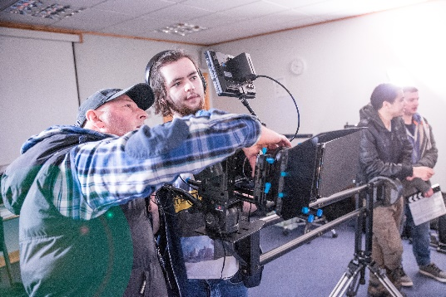

What can you study?
  Business and computing
  Cànan agus cultar na gàidhlig - Gaelic language and culture
  Education, child and youth studies
  Creative industries
  Engineering, construction and technology
  Health and wellbeing
  History, heritage and social studies
  Science, nature and the environment
  Sports, adventure and tourism
Notes:
.

Slide 6
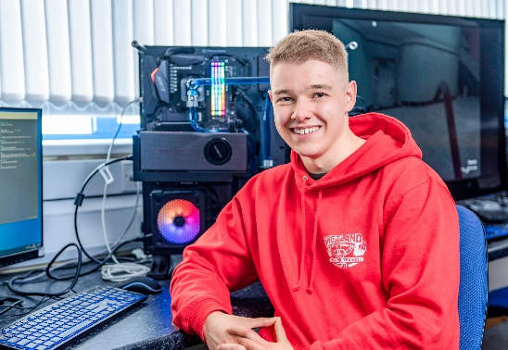



Business and computing
  Accounting
  Administration
  Business and management
  Computing
  Events
  Finance
  Hospitality management
  Interactive media
  Software development
  Professional cookery
  Technological education

Slide 7



Cànan agus cultar na Gàidhlig
Gaelic language and culture
  Gàidhlig
  Gàidhlig agus foghlam
  Gàidhlig agus ceòl traidiseanta
  Na meadhanan Gàidhlig
  Arc-eòlas le Gàidhlig
  Cultar agus dualchas le Gàidhlig
  Eachdraidh le Gàidhlig
  Seasmhach leasachadh le Gàidhlig
  Gaelic
  Gaelic and education
  Gaelic and traditional music
  Gaelic media
  Archaeology with Gaelic
  Culture and heritage with Gaelic
  History with Gaelic
  Sustainable development with Gaelic

Slide 8

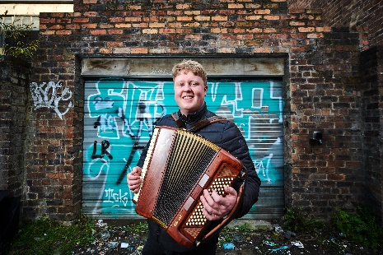
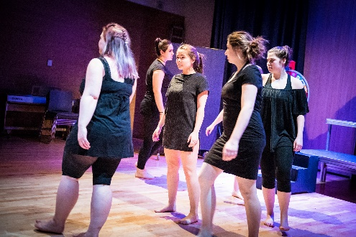

Creative industries
  Audio engineering
  Creative writing
  Drama, acting and performance
  Film making
  Fine art
  Jewellery design and production
  Music
  Music business
  Musical and theatre studies
  Photography
  Visual communication and design

Slide 9
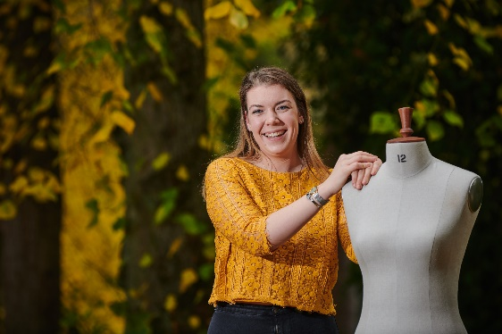
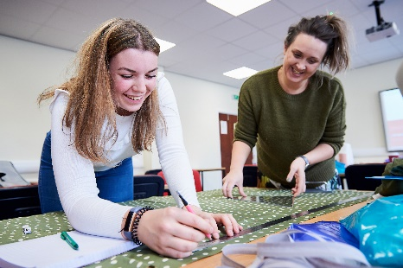


Education, child and youth studies
  Child and youth studies
  Early learning and childcare
  Gaelic and education
  Food, nutrition and textiles education
  Moral and philosophical studies with religious education
  Technological education
  PGDE (post graduate diploma in education)

Slide 10
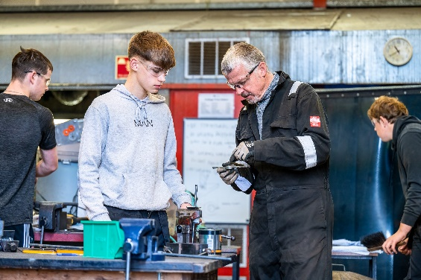
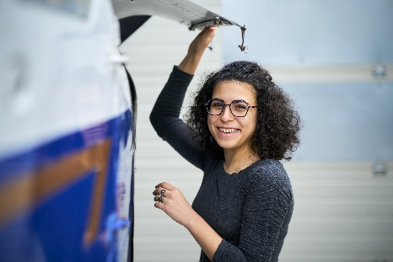


Engineering, construction and technology
  Aircraft engineering
  Architectural studies
  Civil engineering
  Construction and the built environment
  Electrical and electronic engineering
  Energy engineering
  Mechanical engineering
  Technological education

Slide 11




Health and wellbeing
  Adult or mental health nursing
  Health and social studies
  Integrative healthcare
  Optometry
  Oral health science
  Psychology

Slide 12


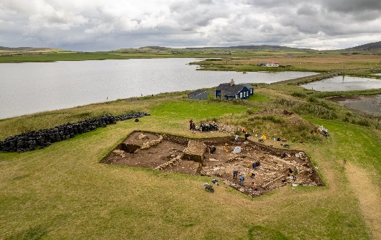

History, heritage and social studies
  Archaeology
  Criminology
  Culture and history
  Geography
  History
  Literature
  Philosophy
  Politics
  Social sciences
  Sociology
  Sustainable development
  Theology
  Over 40 joint honour programmes
Notes:
Over in our Humanities and social sciences subjects (which is what we at UHI call Modern and Social Studies), we have a range of single honours degree programmes you can also choose from over 40 joint honour degree programmes too.
For example you can combine archaeology with criminology, philosophy with politics, sociology and theology

Slide 13
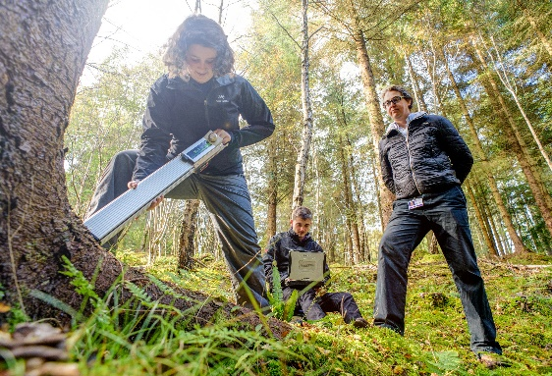
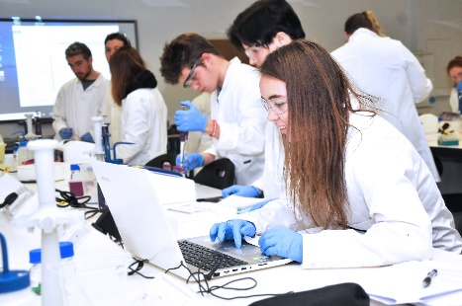


Science, nature and the environment
  Archaeological science
  Environmental science
  Forest management
  Geography
  Marine science
  Sustainable development

Slide 14




Sports, adventure and tourism
  Adventure studies
  Equine business management
  Golf
  Sport and fitness
  Sports therapy and rehabilitation

Slide 15
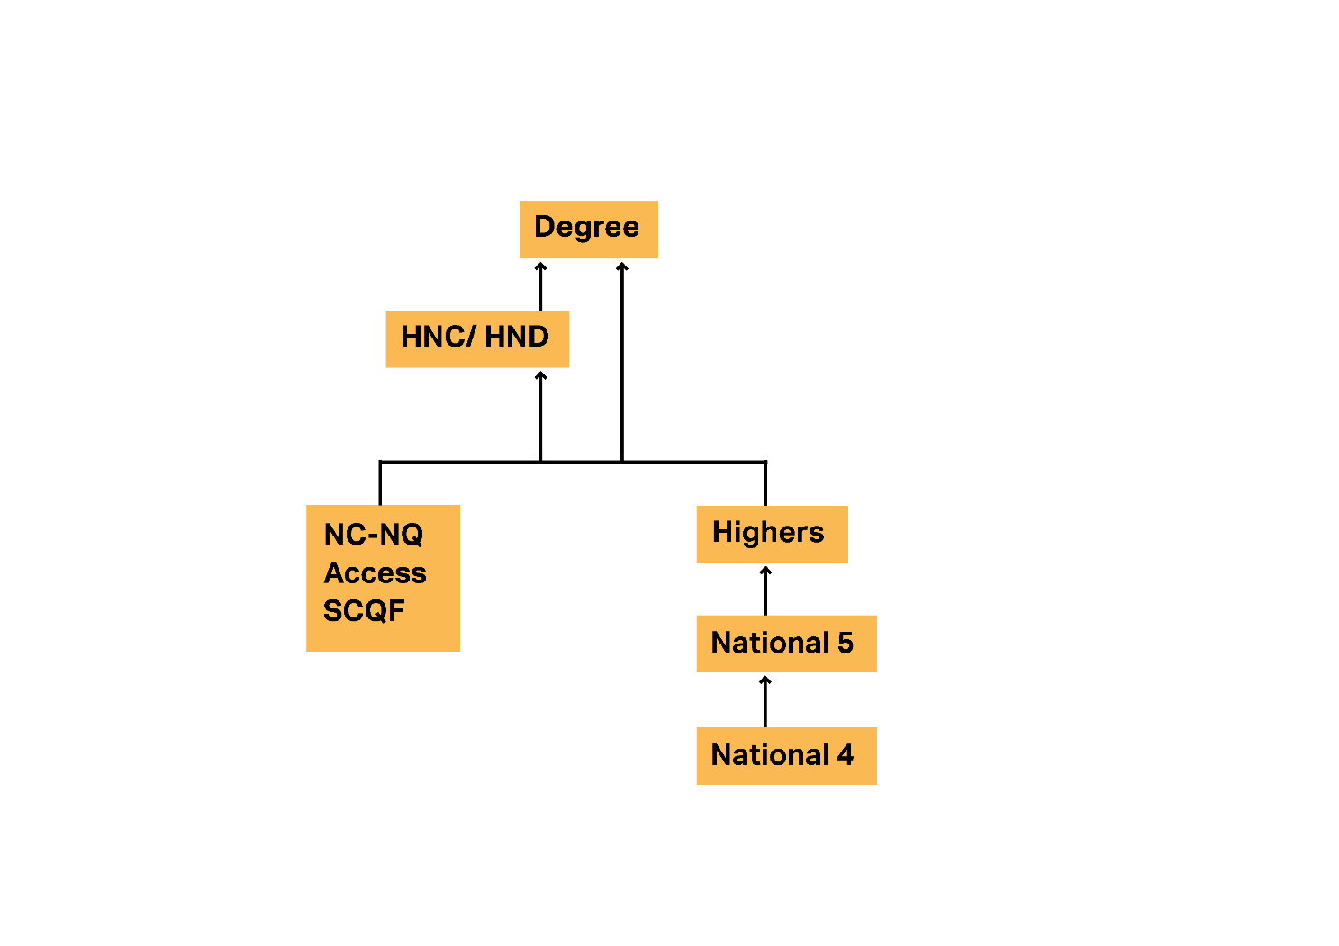
Progress with UHI

Slide 16
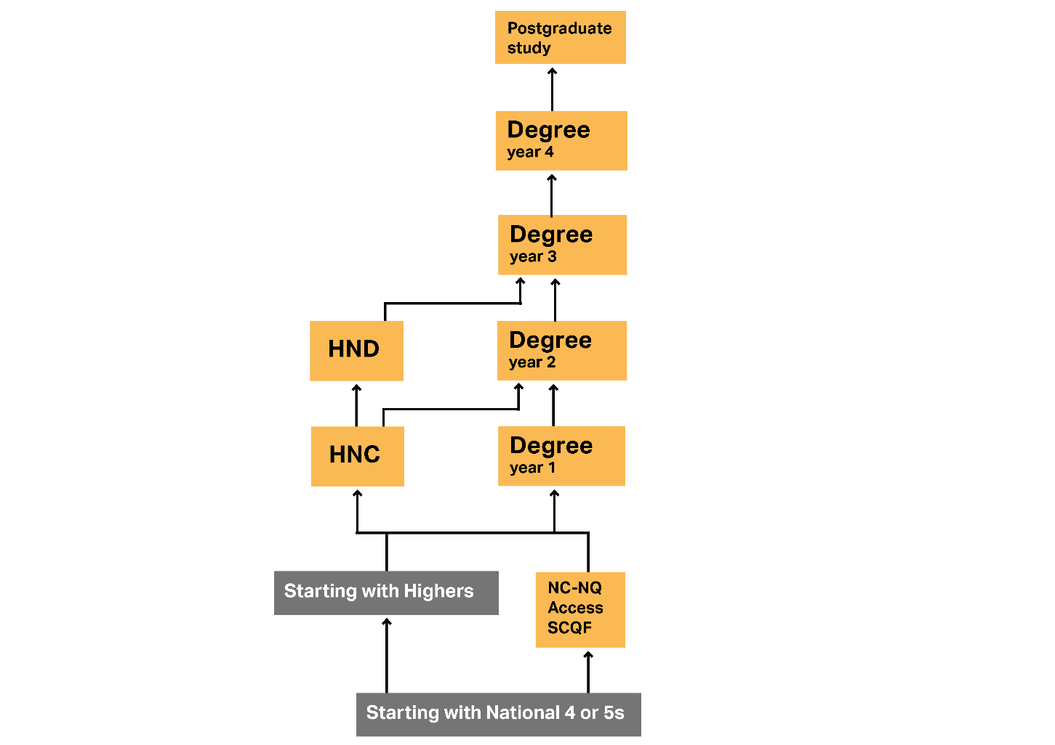
Progress with UHI

Slide 17

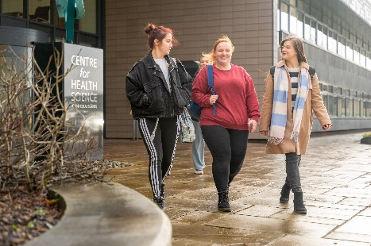


On Campus
  While you are with us, we are committed to enhancing your student experience and ensuring that you can reach your full potential, offering a full range of Support. This can include:
  Funding and financial support
  Inclusive and learning support
  Support for wellbeing and mental health
  Clubs and societies

Slide 18



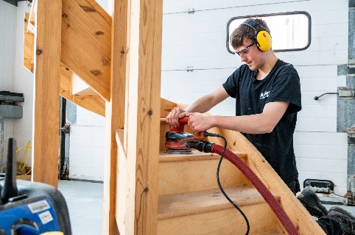
Careers and Employability
  Careers and employability service
  Handshake - a dedicated platform for all UHI students to help you find the jobs that you’re looking for both during and after your studies
    Trusted by 900+ universities and 425K employers worldwide
    UHI the only university in Scotland using Handshake
  Employer mentoring programme
  Graduates are fully equipped with many transferrable skills that employers are looking for
  Graduates are recognised as a "Graduate for Life" and so have careers support for life

Slide 19

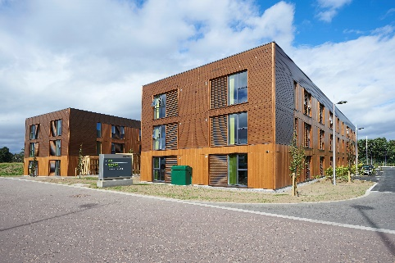

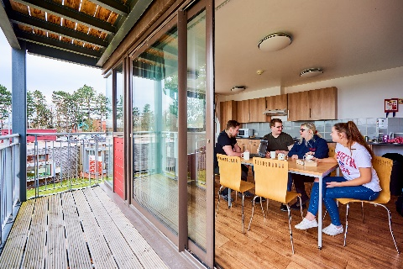
Accommodation
  Starting university can be a daunting prospect, especially if you are moving away from home
  Most of our campuses offer dedicated student accommodation designed around the needs of our students
  For campuses which do not have dedicated student accommodation, or for students who prefer private rented accommodation, assistance is available to find suitable lodgings if required
  Types of accommodation and costs will vary depending on your location of study

Slide 20
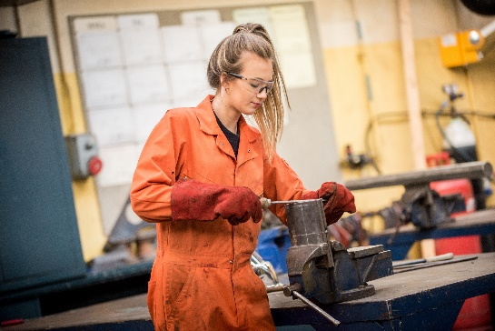
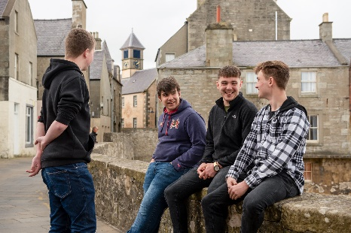


How to apply
  If you would like to study a degree, HNC or HND you will apply through UCAS
  For everything else, apply via the UHI website

Slide 21

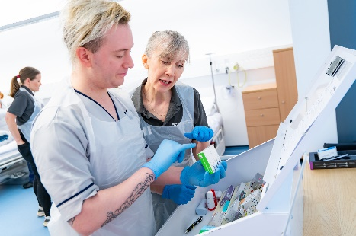
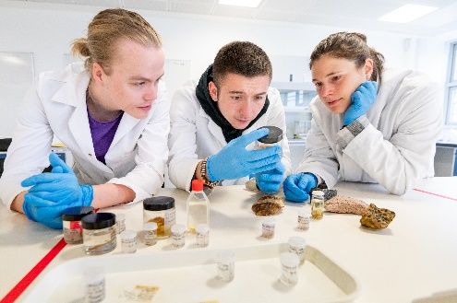

How to apply to UCAS
  Deadlines
  13 January 2027 for the Equal consideration deadline (ECD)
  We will accept applications until September if we still have places
  Application form
  Personal details; course(s); education; employment; personal statement; and referee

Slide 22
Where learning means more
Far a bheil ionnsachadh a’ciallachadh barrachd
schools@uhi.ac.uk
uhi.ac.uk

